Slide 1
Lecture 14: Visualizing and Understanding

Slide 2
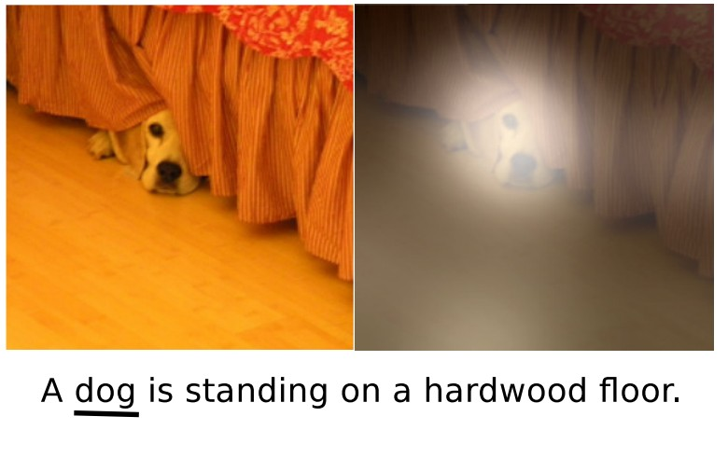
Last Time: Attention
Generalized Self-Attention
Transformers are a new neural network model that only uses attention
Adding Attention to RNN models lets them look at different parts of the input at each timestep
is new, powerful neural network primitive
Y₁ Y₂ Y₃
y₁
y₂
y₃
y₄
Product(→), Sum(↑)
V₃
^{A}1,3 ^{A}2,3 ^{A}3,3
^{A}1,2 ^{A}2,2 ^{A}3,2
^{A}1,1 ^{A}2,1 ^{A}3,1
Softmax(↑)
^{E}1,3 ^{E}2,3 ^{E}3,3
^{E}1,2 ^{E}2,2 ^{E}3,2
^{E}1,1 ^{E}2,1 ^{E}3,1
Q₁ Q₂ Q₃
X₁ X₂ X₃
Layer Normalization
V₂
+
V₁
MLP
MLP
MLP
MLP
K₃
Layer Normalization
K₂
+
K₁
Self-Attention
x₁
x₂
x₃
x₄
Xu et al, “Show, Attend, and Tell: Neural Image Caption Generation with Visual Attention”, ICML 2015

Slide 3
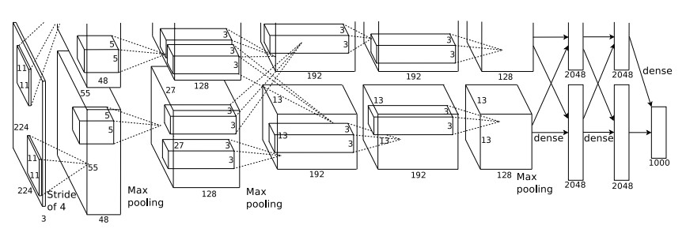
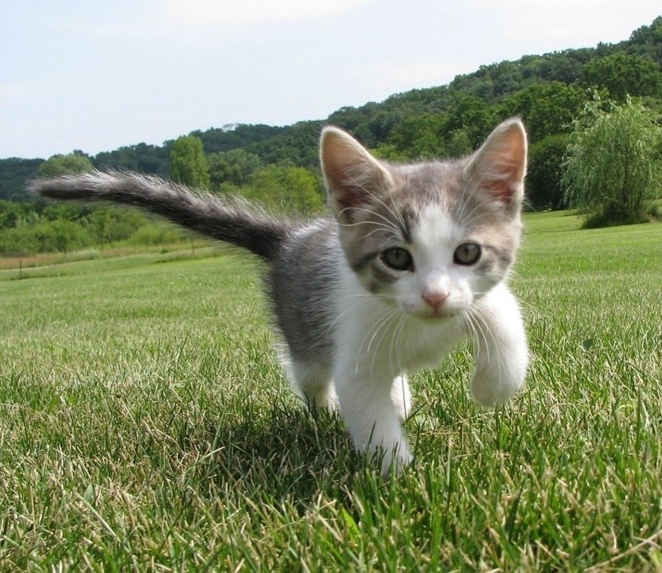
What’s going on inside Convolutional Networks?
This image is CC0 public domain
Class Scores: 1000 numbers
Input Image: 3 x 224 x 224
What are the intermediate features looking for?
Krizhevsky et al, “ImageNet Classification with Deep Convolutional Neural Networks”, NeurIPS 2012.

Slide 4
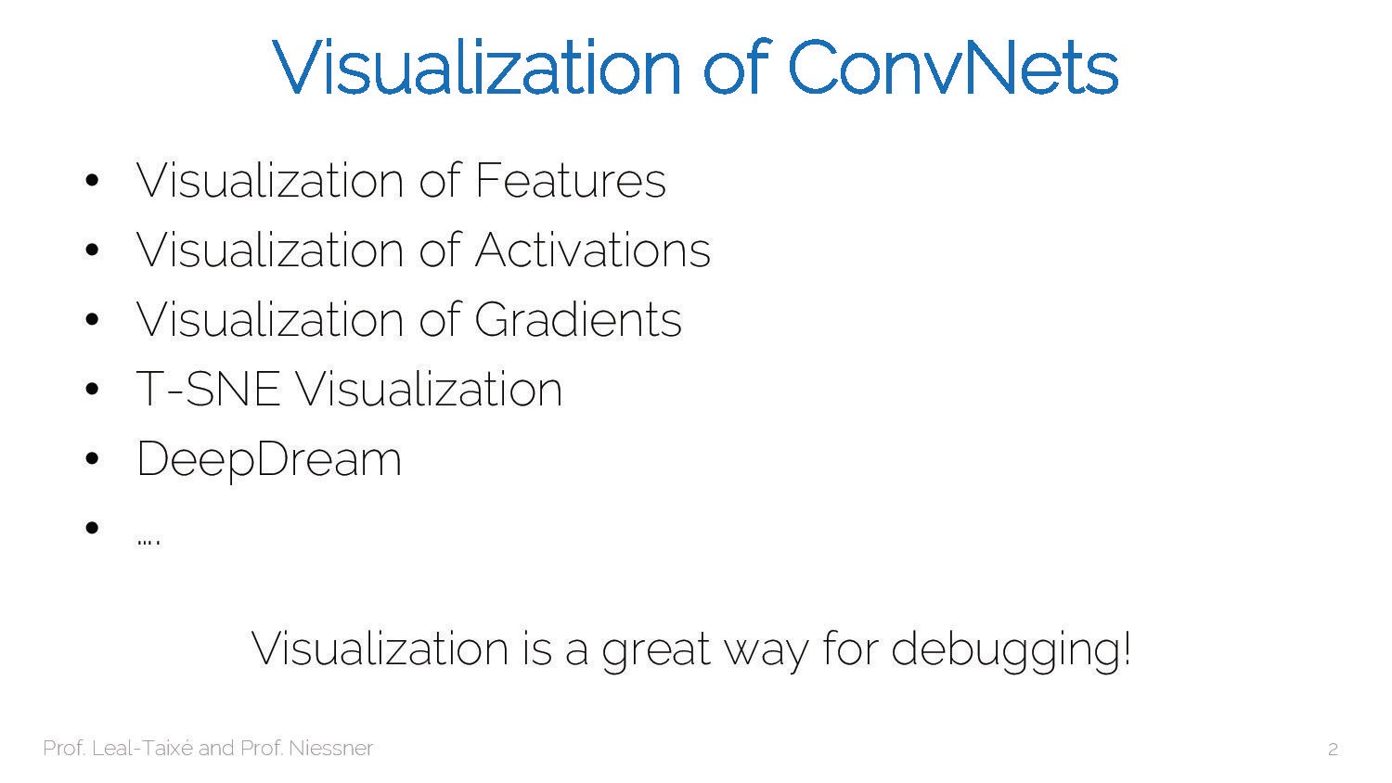

Slide 5
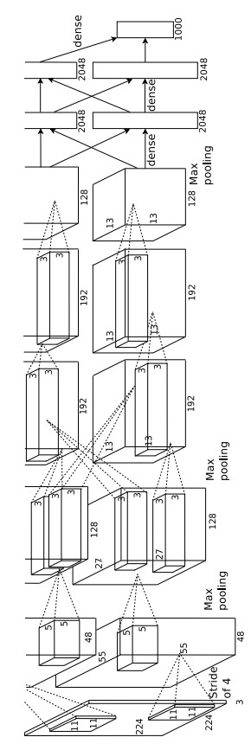
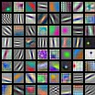
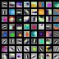
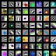
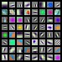
First Layer: Visualize Filters
ResNet-18: 64 x 3 x 7 x 7
ResNet-101: 64 x 3 x 7 x 7
DenseNet-121: 64 x 3 x 7 x 7
AlexNet: 64 x 3 x 11 x 11
Krizhevsky, “One weird trick for parallelizing convolutional neural networks”, arXiv 2014 He et al, “Deep Residual Learning for Image Recognition”, CVPR 2016
Huang et al, “Densely Connected Convolutional Networks”, CVPR 2017

Slide 6
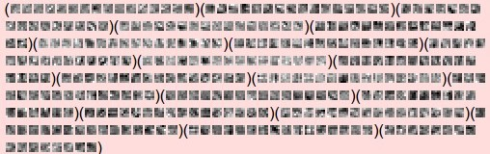
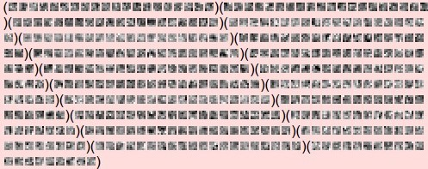
Higher Layers: Visualize Filters
First layer weights: 16 x 3 x 7 x 7
Second layer weights: 20 x 16 x 7 x 7
We can visualize filters at higher layers, but not that interesting
Source: ConvNetJS CIFAR-10 example
https://cs.stanford.edu/people/karpathy
/convnetjs/demo/cifar10.html
Third layer weights: 20 x 20 x 7 x 7

Slide 7
Last Layer
FC7 layer
4096-dimensional feature vector for an image (layer immediately before the classifier)
Run the network on many images, collect the feature vectors
Krizhevsky et al, “ImageNet Classification with Deep Convolutional Neural Networks”, NeurIPS 2012. Figures reproduced with permission.

Slide 8
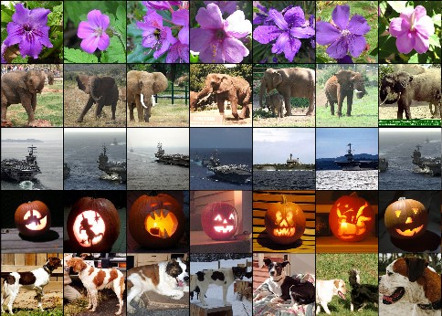
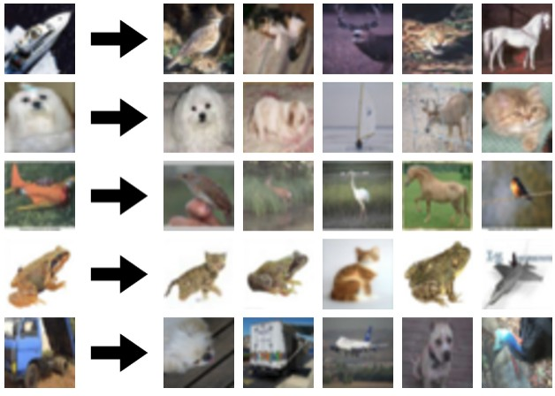
Last Layer: Nearest Neighbors
Test
_{image} L2 Nearest neighbors in feature space
Recall: Nearest neighbors in pixel space
Krizhevsky et al, “ImageNet Classification with Deep Convolutional Neural Networks”, NeurIPS 2012. Figures reproduced with permission.

Slide 9
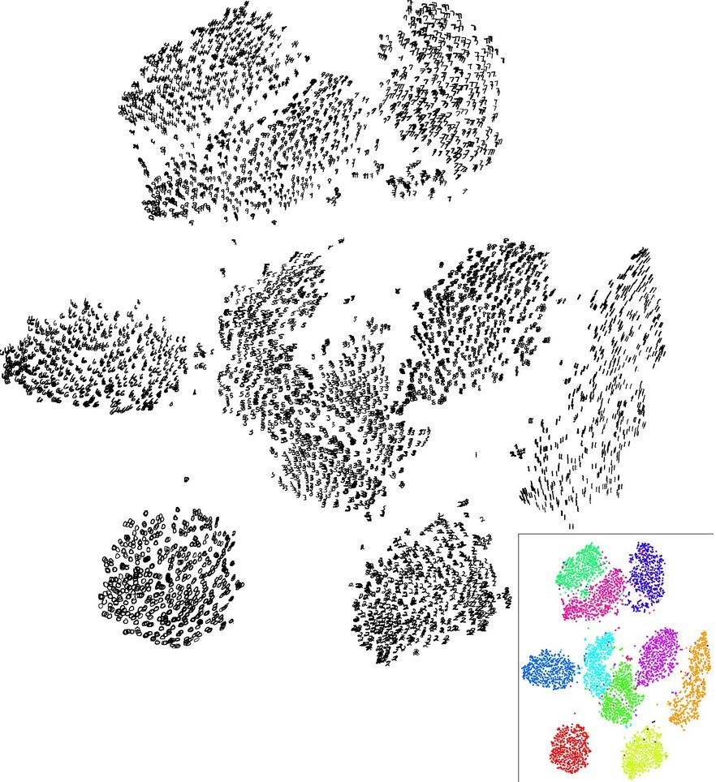
Last Layer: Dimensionality Reduction
Visualize the “space” of FC7 feature vectors by reducing dimensionality of vectors from 4096 to 2 dimensions
Simple algorithm: Principal Component Analysis (PCA)
More complex: t-SNE
Van der Maaten and Hinton, “Visualizing Data using t-SNE”, JMLR 2008 Figure copyright Laurens van der Maaten and Geoff Hinton, 2008. Reproduced with permission.
Lecture 14 - 10

Slide 10
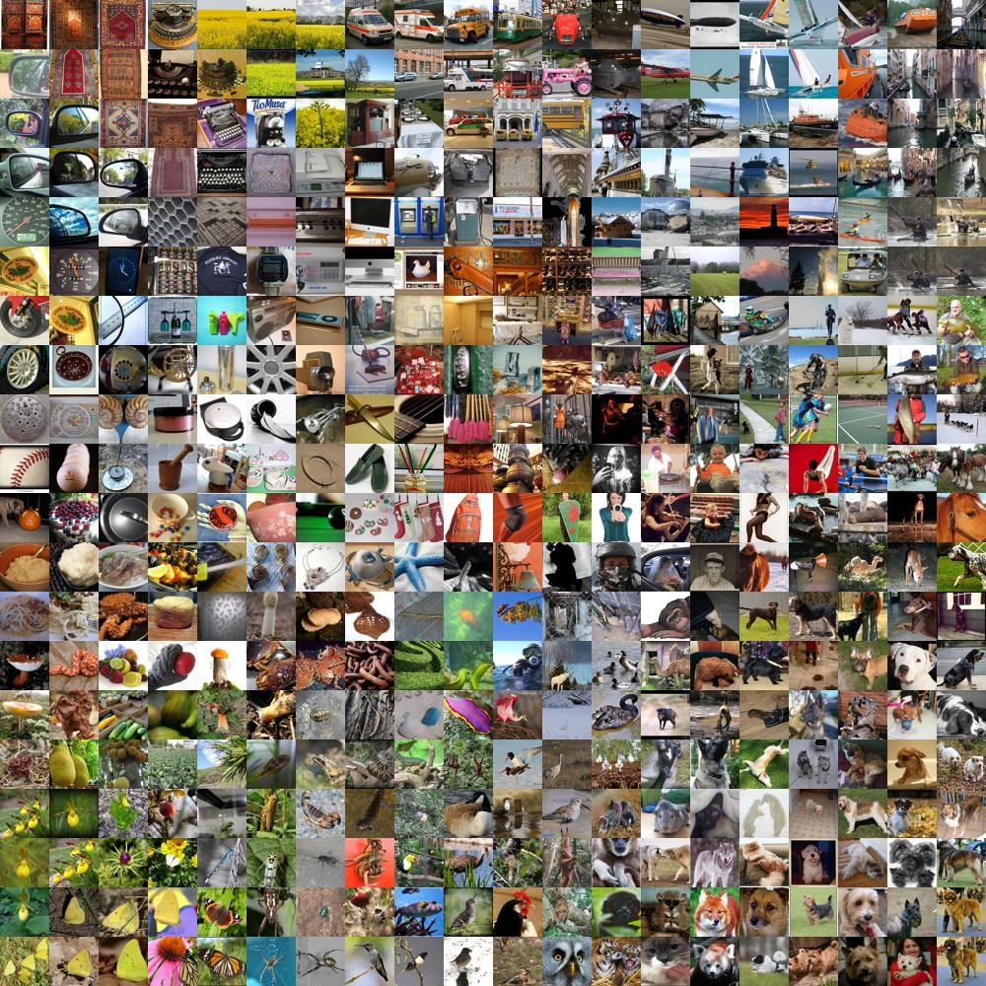
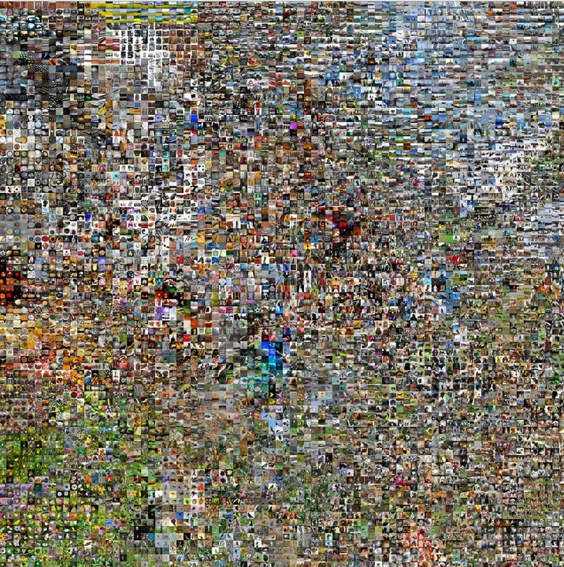
Last Layer: Dimensionality Reduction
Van der Maaten and Hinton, “Visualizing Data using t-SNE”, JMLR 2008 Krizhevsky et al, “ImageNet Classification with Deep Convolutional Neural Networks”, NIPS 2012.
See high-resolution versions at
Figure reproduced with permission.
http://cs.stanford.edu/people/karpathy/cnnembed/
Lecture 14 - 11

Slide 11
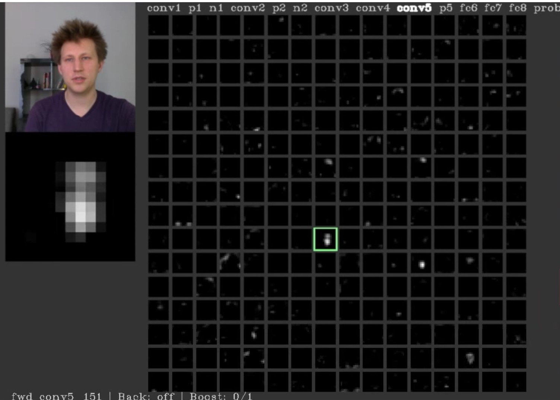
Visualizing Activations
conv5 feature map is 128x13x13; visualize as 128 13x13 grayscale images
Yosinski et al, “Understanding Neural Networks Through Deep Visualization”, ICML DL Workshop 2014. Figure copyright Jason Yosinski, 2014. Reproduced with permission.

Slide 12
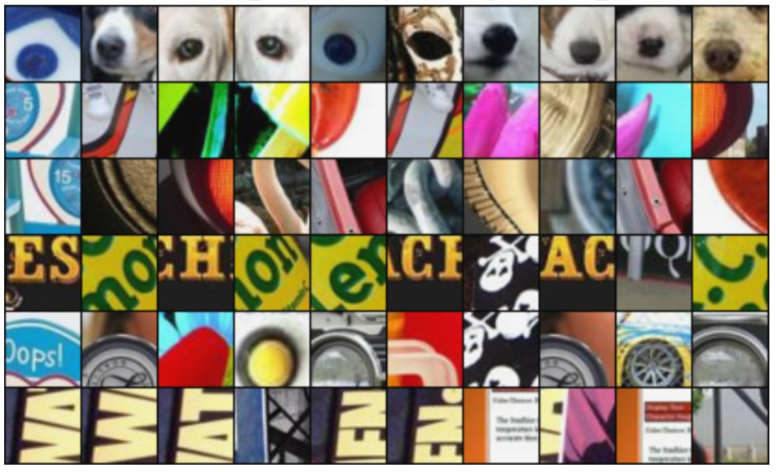
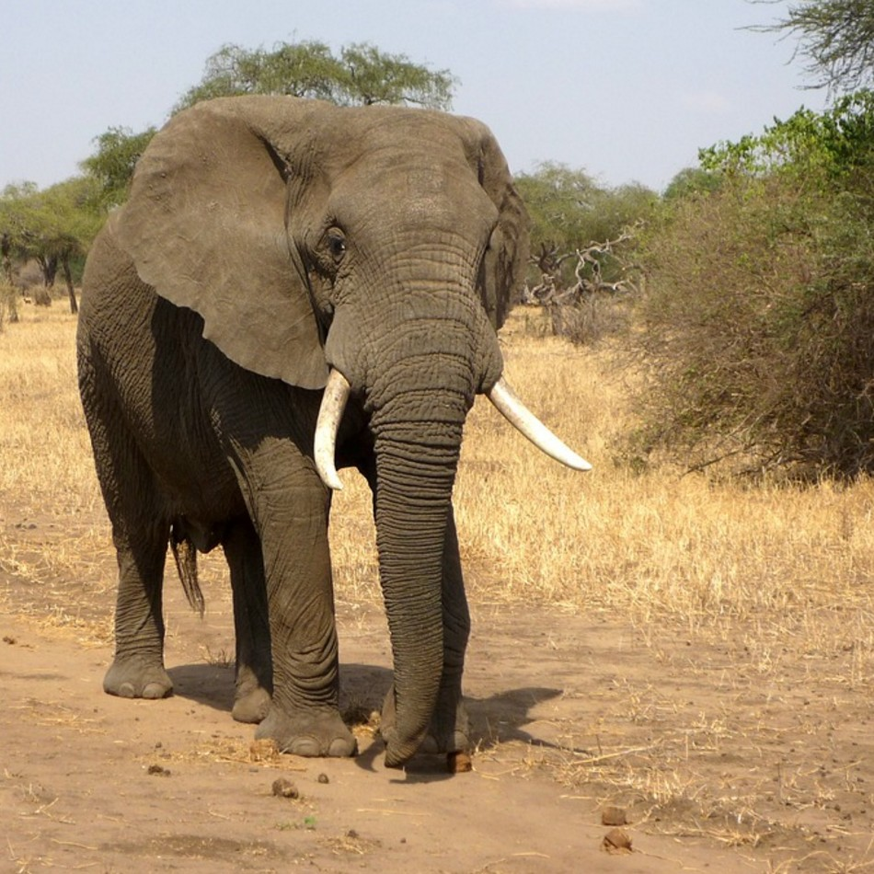
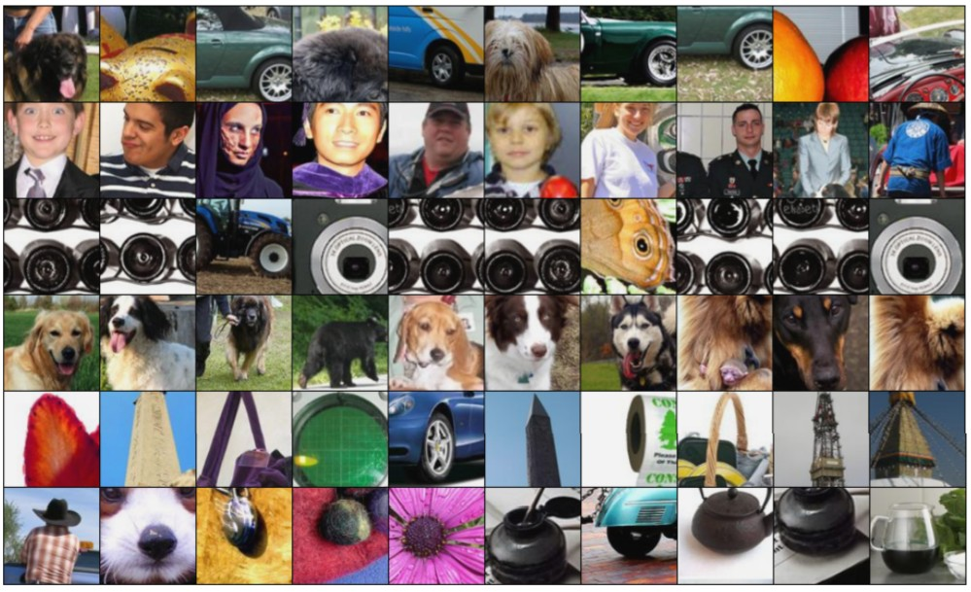
Maximally Activating Patches
Pick a layer and a channel; e.g. conv5 is 128 x 13 x 13, pick channel 17/128
Run many images through the network, record values of chosen channel
Visualize image patches that correspond to maximal activations
Springenberg et al, “Striving for Simplicity: The All Convolutional Net”, ICLR Workshop 2015 Figure copyright Jost Tobias Springenberg, Alexey Dosovitskiy, Thomas Brox, Martin Riedmiller, 2015; reproduced with permission.

Slide 13
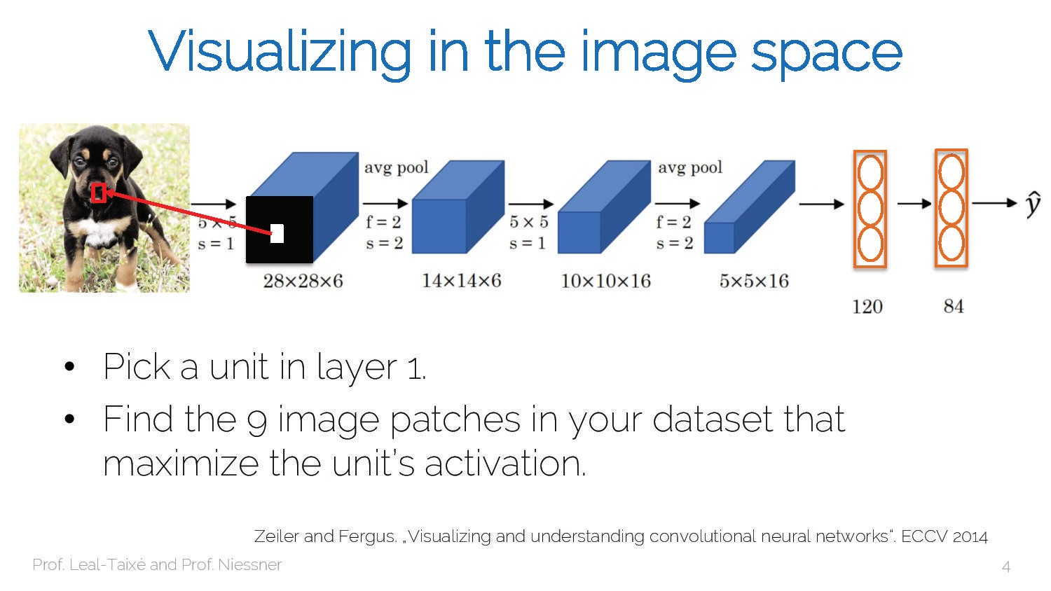

Slide 14
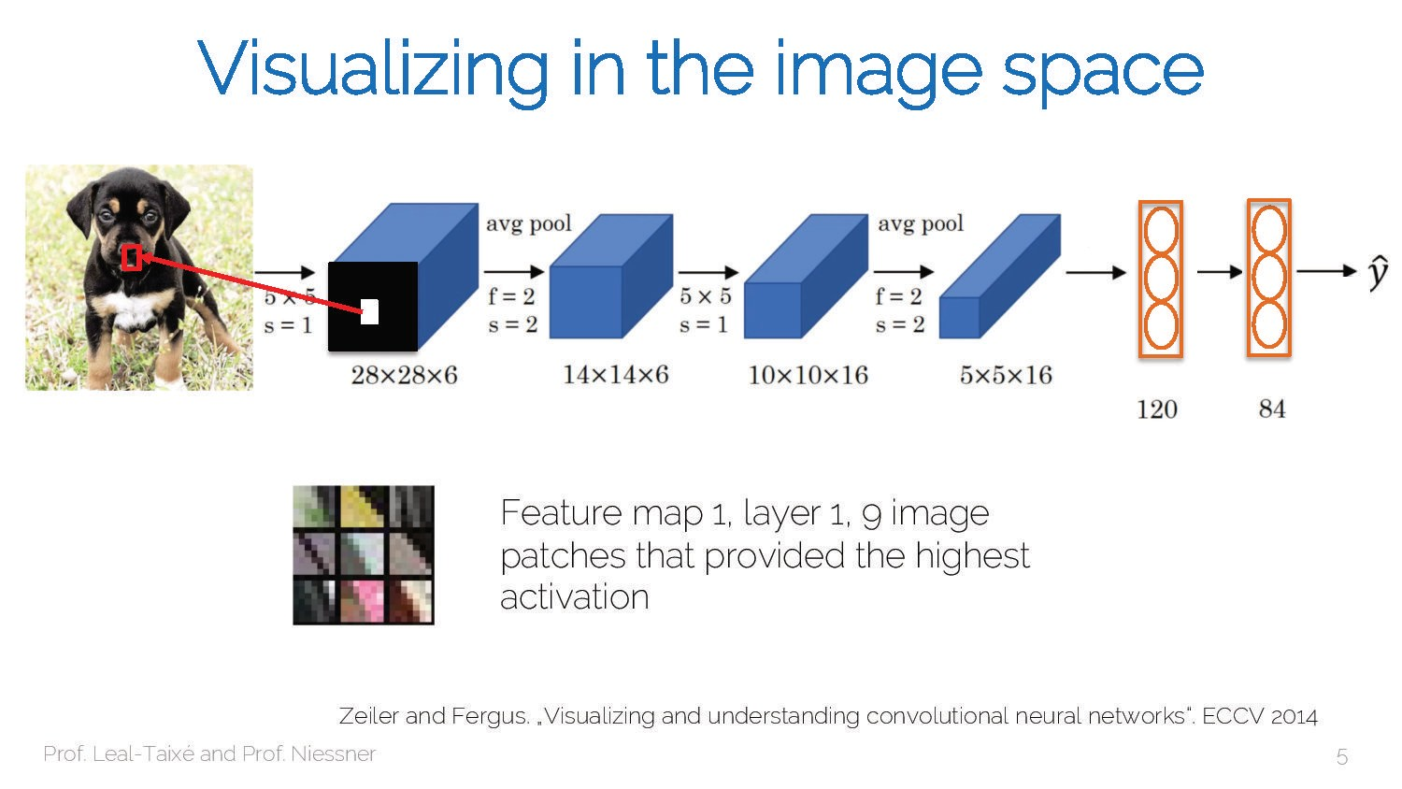

Slide 15
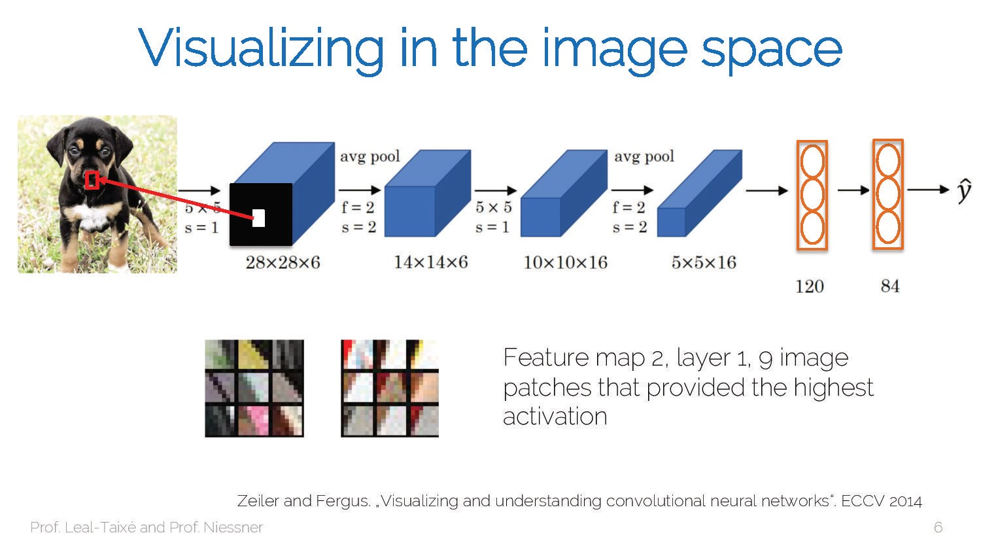

Slide 16
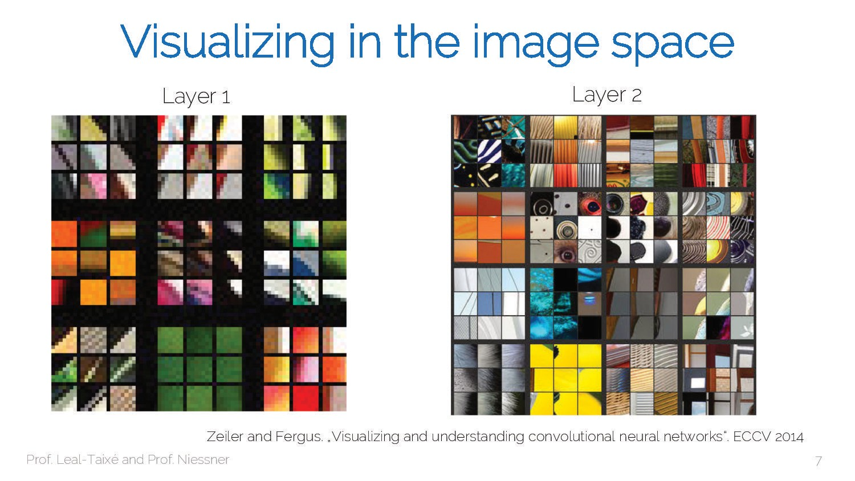

Slide 17
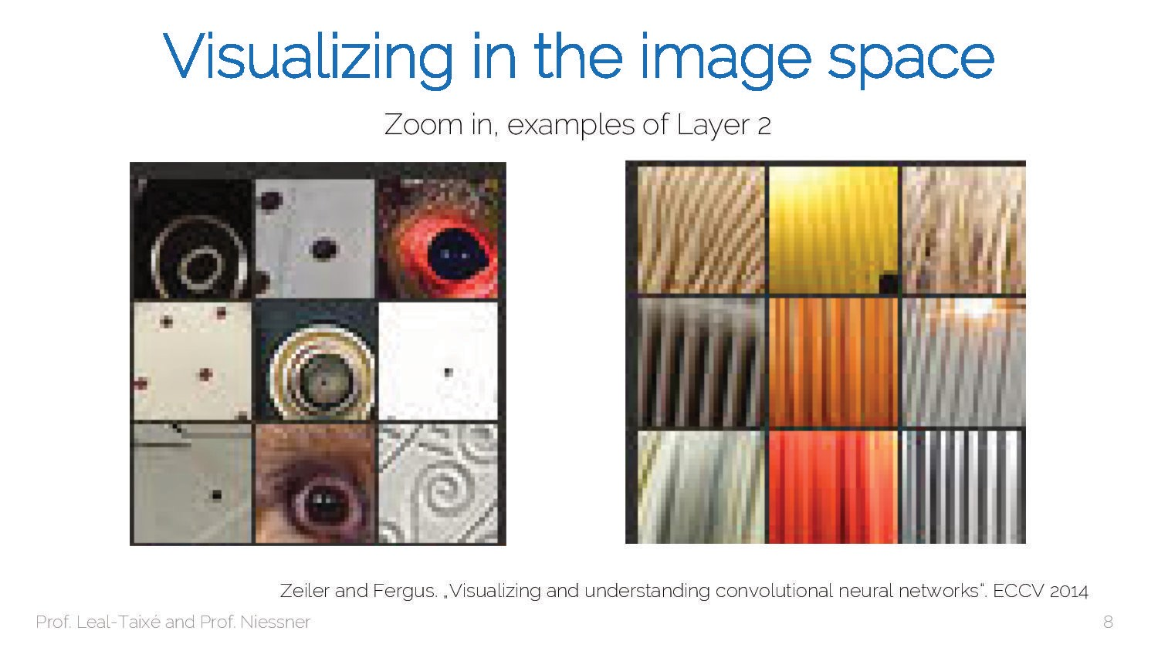

Slide 18
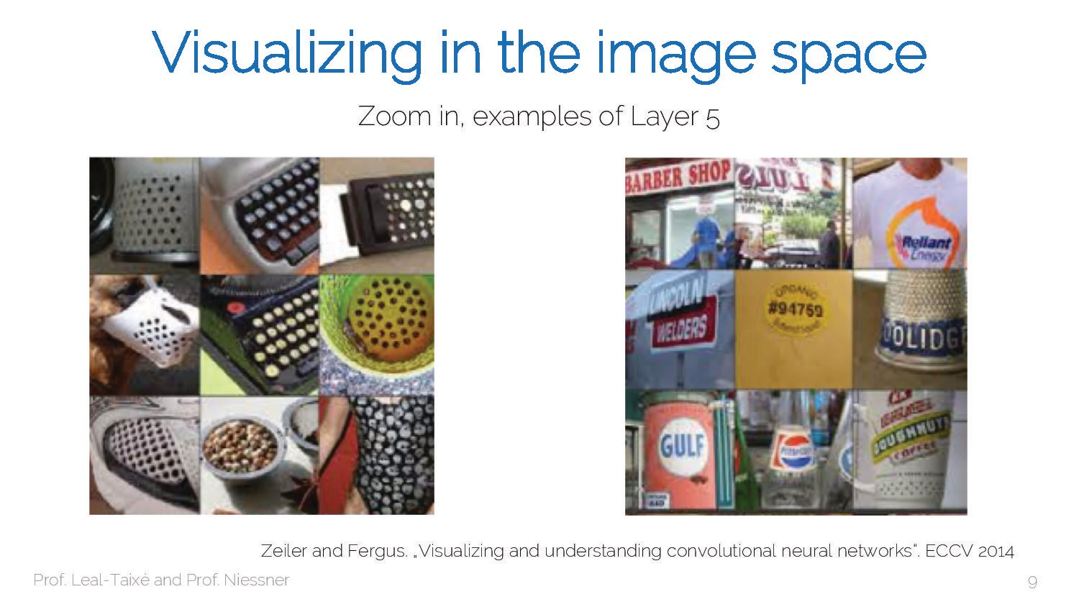

Slide 19
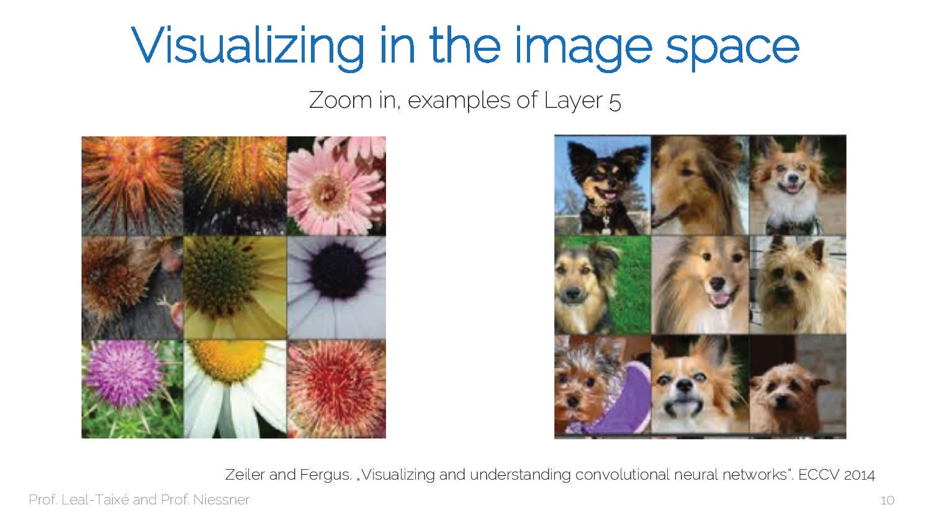

Slide 20
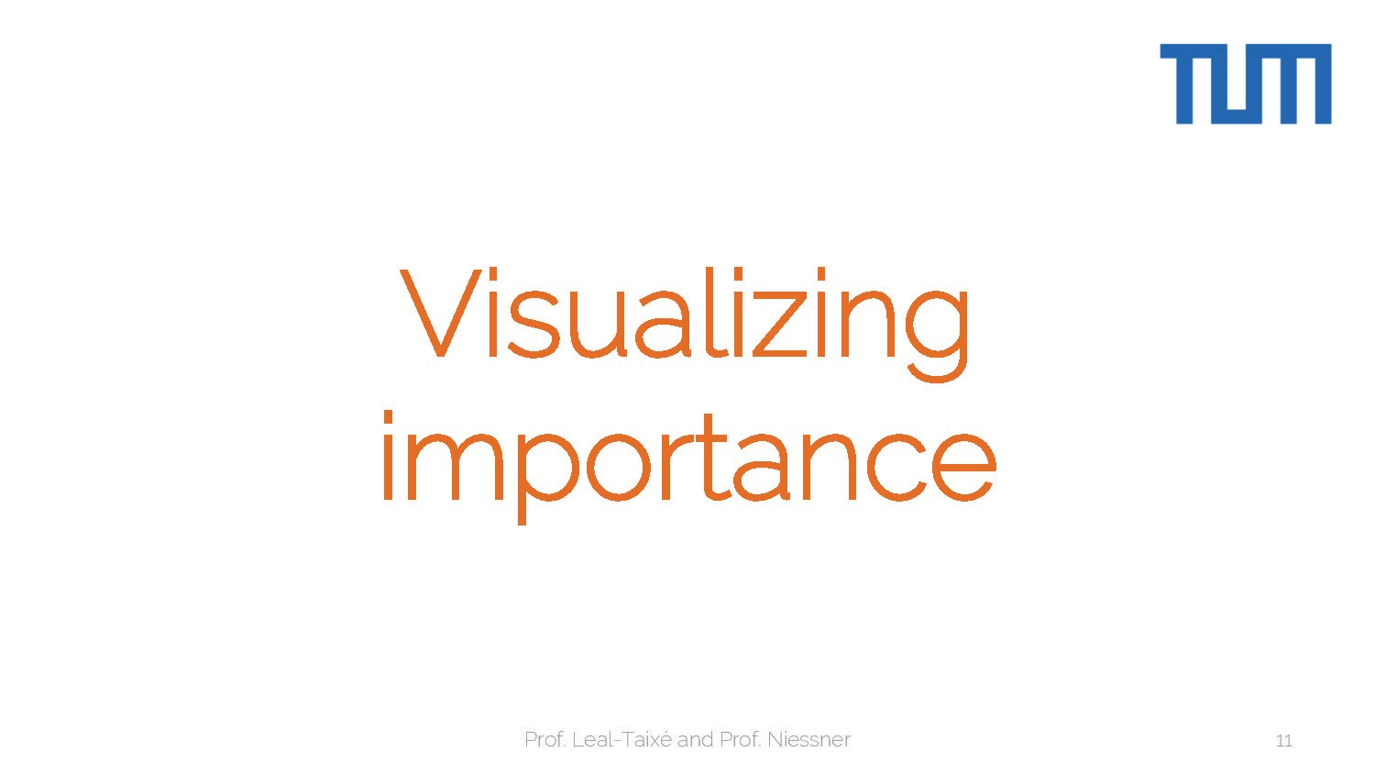

Slide 21
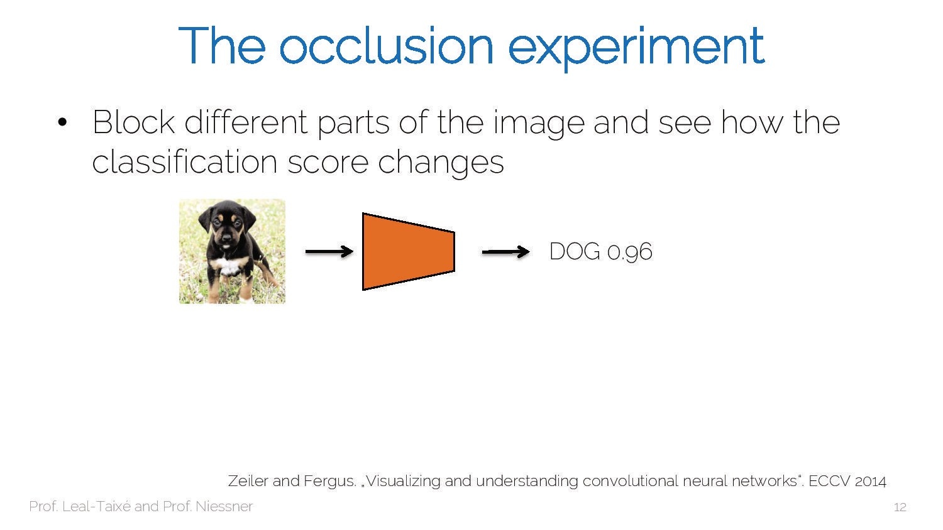

Slide 22
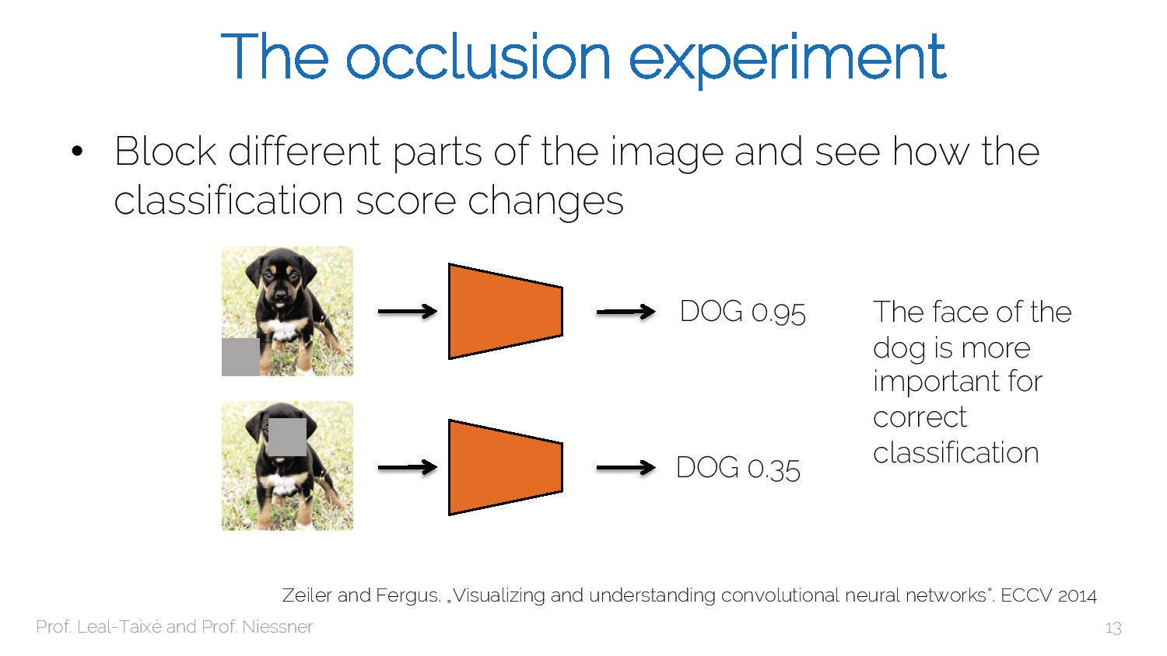

Slide 23
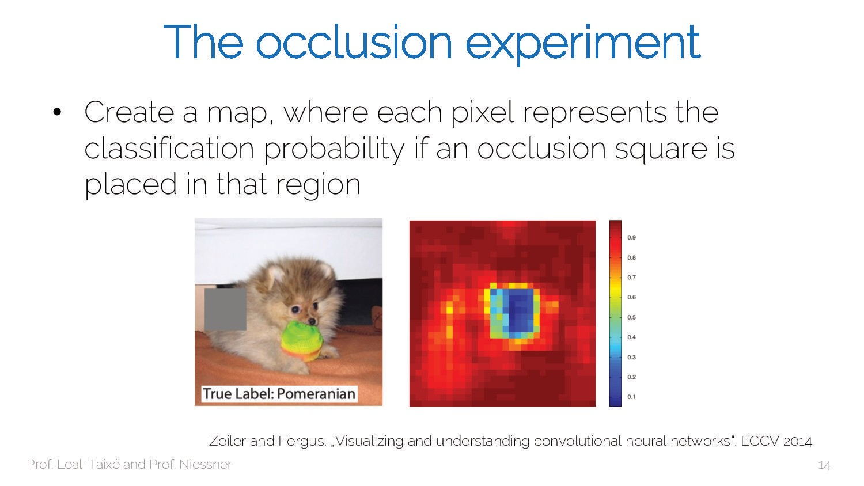

Slide 24
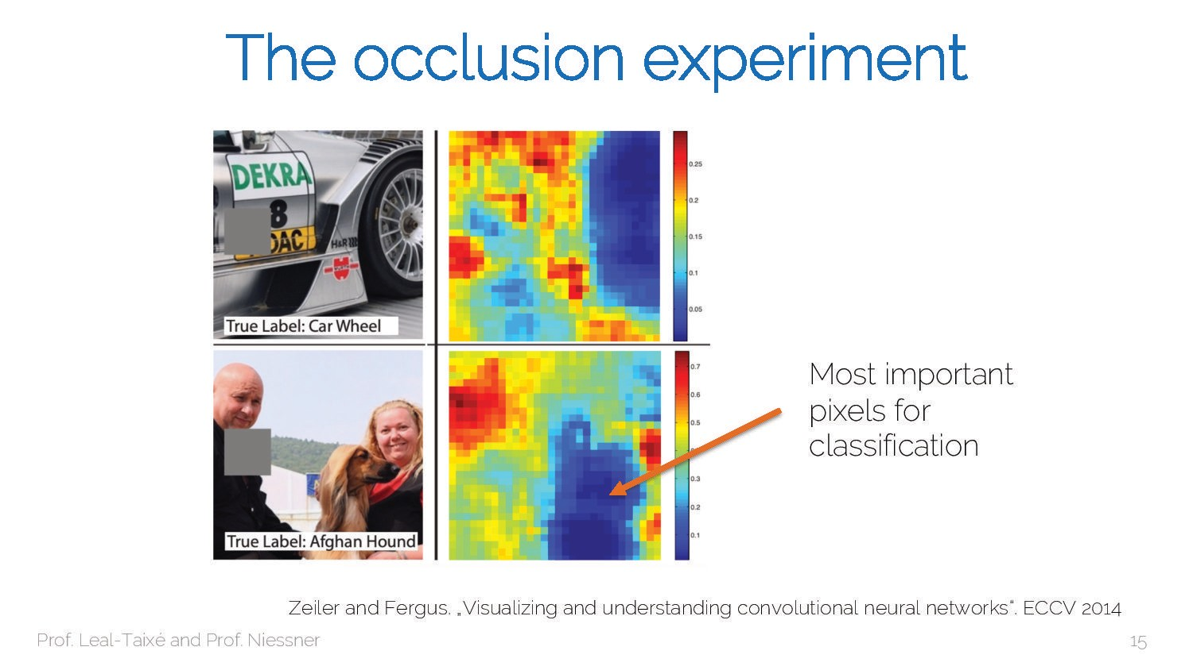

Slide 25
Which Pixels Matter? Saliency via Occlusion
Mask part of the image before feeding to CNN, check how much predicted probabilities change
Boat image is CC0 public domain Elephant image is CC0 public domain Go-Karts image is CC0 public domain
Zeiler and Fergus, “Visualizing and Understanding Convolutional Networks”, ECCV 2014

Slide 26
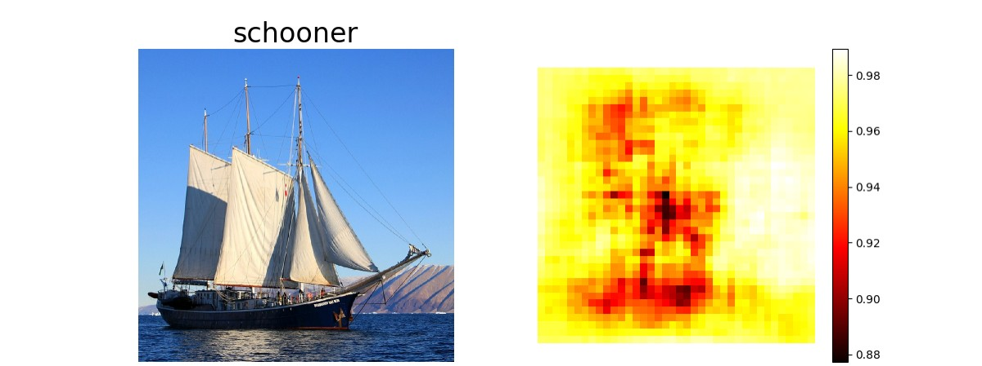
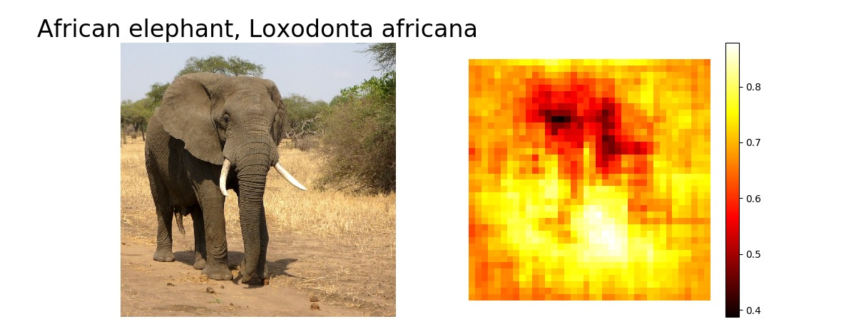
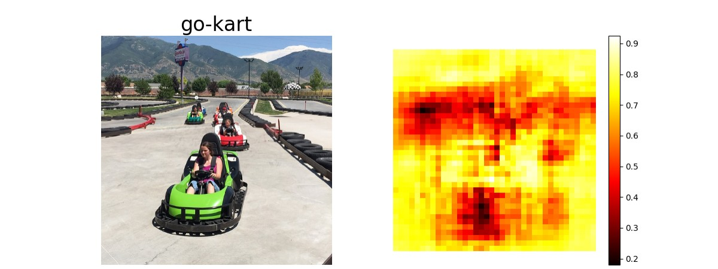
Which Pixels Matter? Saliency via Occlusion
Mask part of the image before feeding to CNN, check how much predicted probabilities change
Boat image is CC0 public domain Elephant image is CC0 public domain Go-Karts image is CC0 public domain
Zeiler and Fergus, “Visualizing and Understanding Convolutional Networks”, ECCV 2014

Slide 27
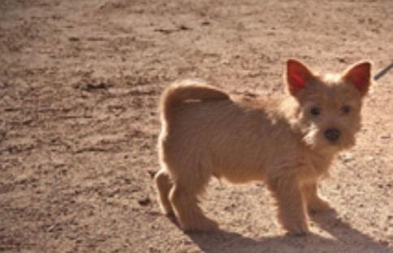
Which pixels matter? Saliency via Backprop
Forward pass: Compute probabilities
Dog
Simonyan, Vedaldi, and Zisserman, “Deep Inside Convolutional Networks: Visualising Image Classification Models and Saliency Maps”, ICLR Workshop 2014. Figures copyright Karen Simonyan, Andrea Vedaldi, and Andrew Zisserman, 2014; reproduced with permission.

Slide 28
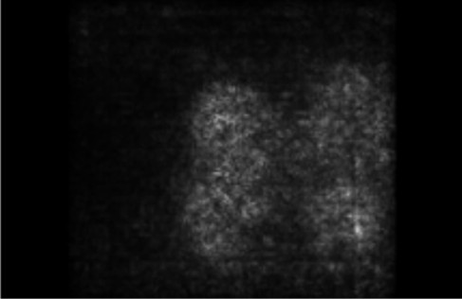
Which pixels matter? Saliency via Backprop
Forward pass: Compute probabilities
Dog
Compute gradient of (unnormalized) class score with respect to image pixels, take absolute value and max over RGB channels
Simonyan, Vedaldi, and Zisserman, “Deep Inside Convolutional Networks: Visualising Image Classification Models and Saliency Maps”, ICLR Workshop 2014. Figures copyright Karen Simonyan, Andrea Vedaldi, and Andrew Zisserman, 2014; reproduced with permission.

Slide 29
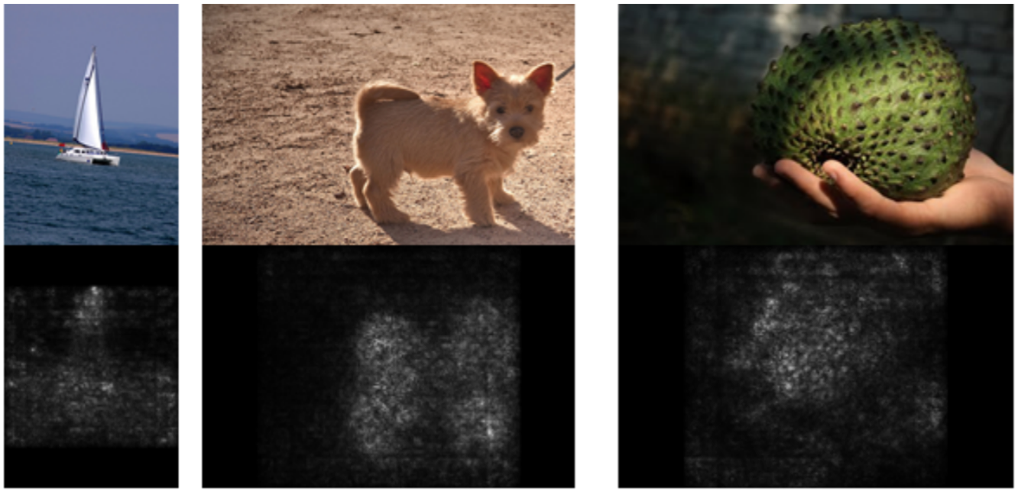
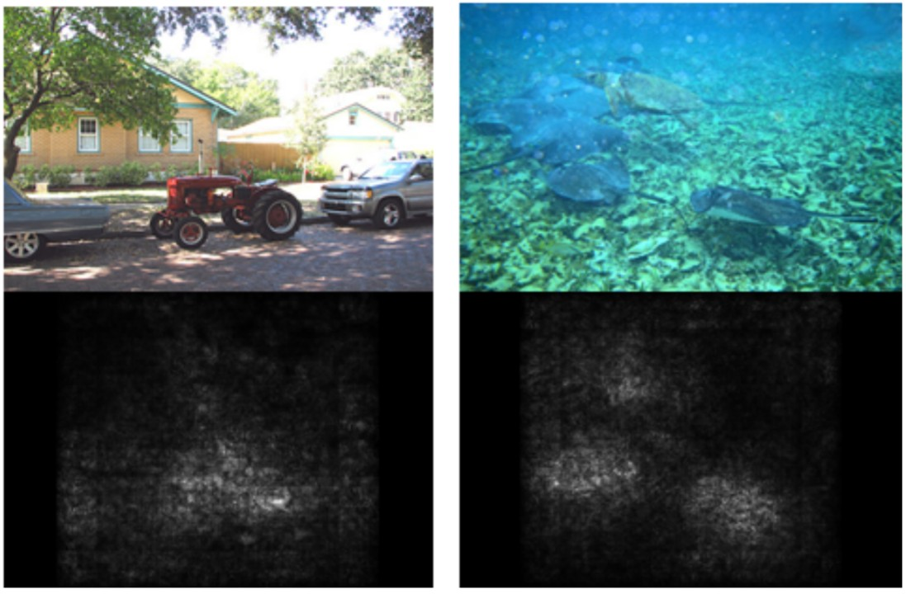
Which pixels matter? Saliency via Backprop
Simonyan, Vedaldi, and Zisserman, “Deep Inside Convolutional Networks: Visualising Image Classification Models and Saliency Maps”, ICLR Workshop 2014. Figures copyright Karen Simonyan, Andrea Vedaldi, and Andrew Zisserman, 2014; reproduced with permission.

Slide 30
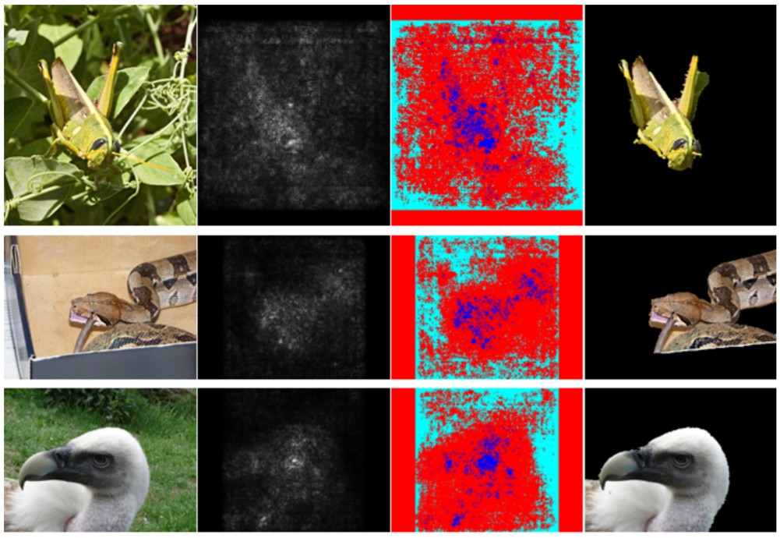
Saliency Maps: Segmentation without Supervision
Use GrabCut on saliency map
Simonyan, Vedaldi, and Zisserman, “Deep Inside Convolutional Networks: Visualising Image Classification Models and Saliency Maps”, ICLR Workshop 2014.
Figures copyright Karen Simonyan, Andrea Vedaldi, and Andrew Zisserman, 2014; reproduced with permission. Rother et al, “Grabcut: Interactive foreground extraction using iterated graph cuts”, ACM TOG 2004
Lecture 14 - 19

Slide 31


Slide 32
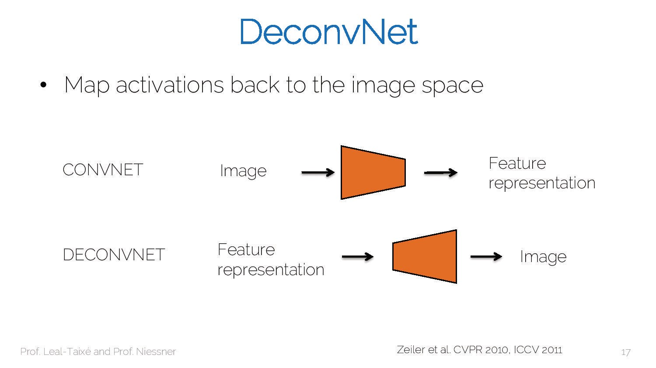

Slide 33
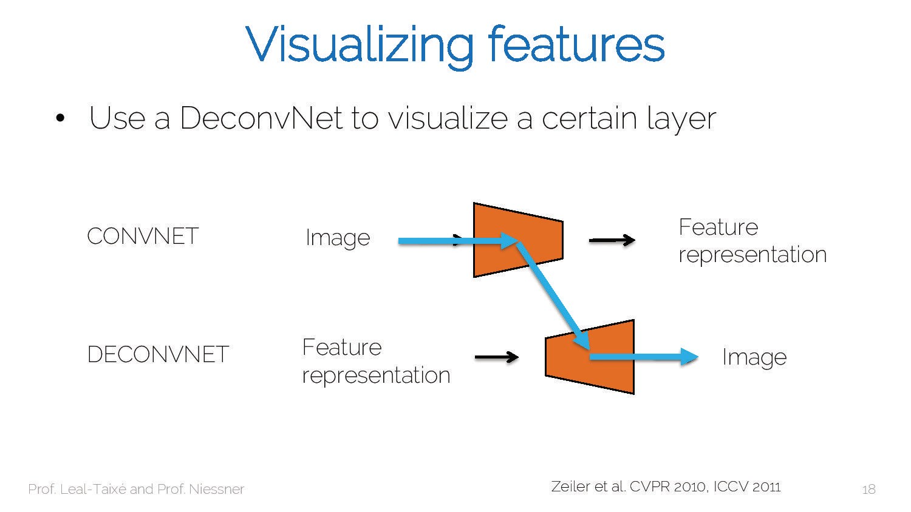

Slide 34
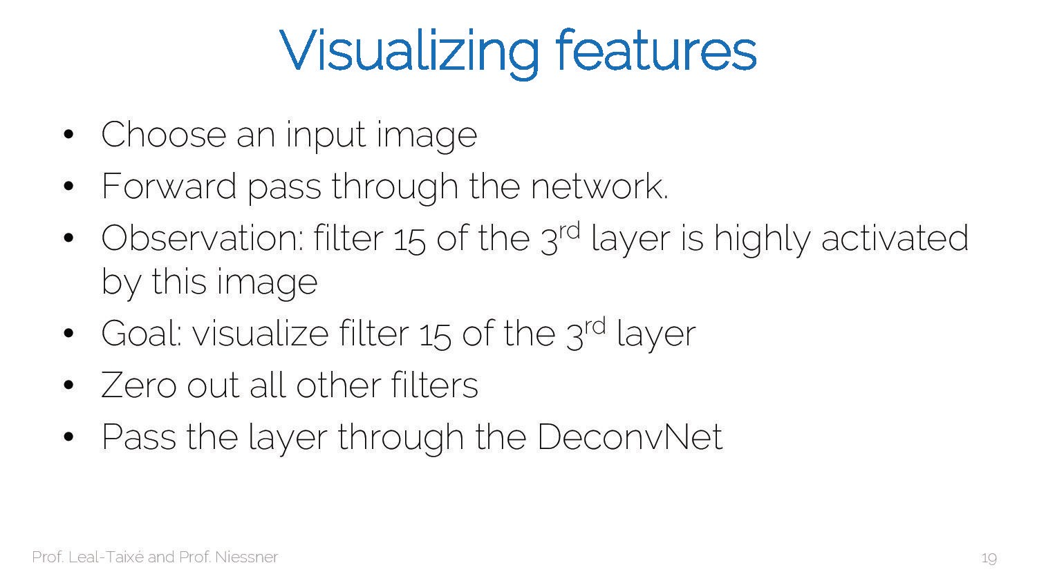

Slide 35
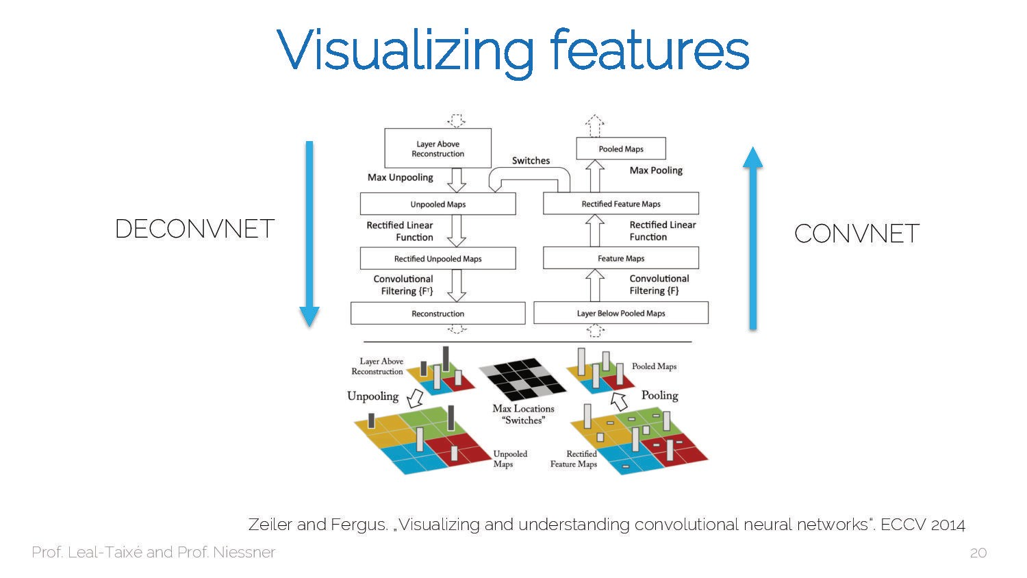

Slide 36
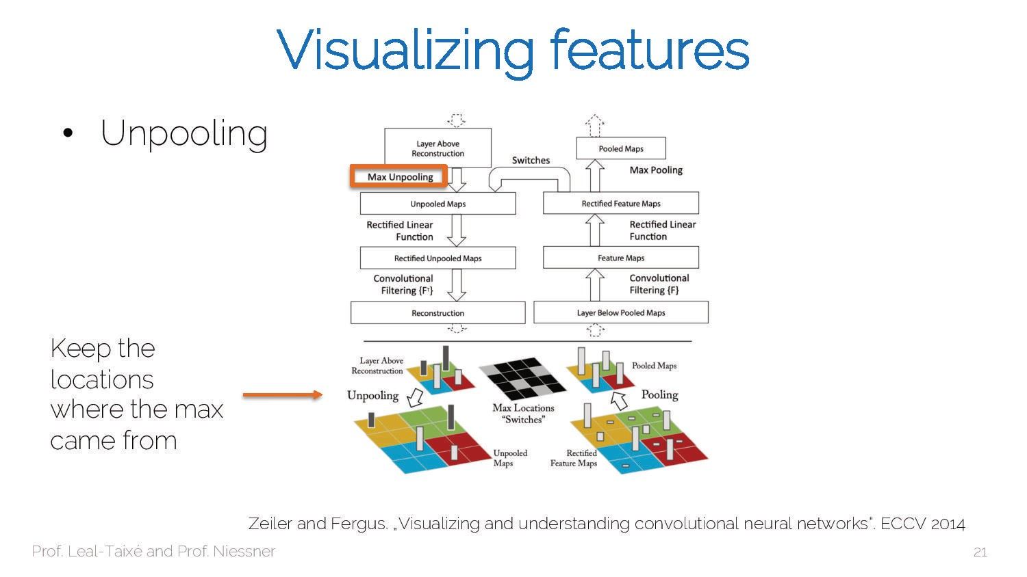

Slide 37
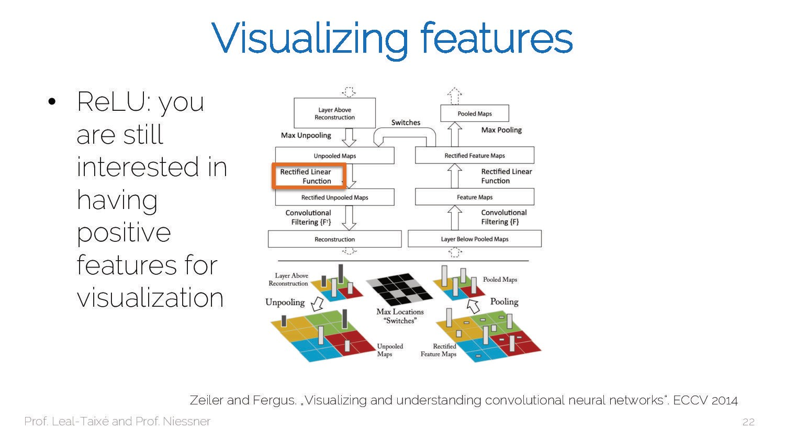

Slide 38
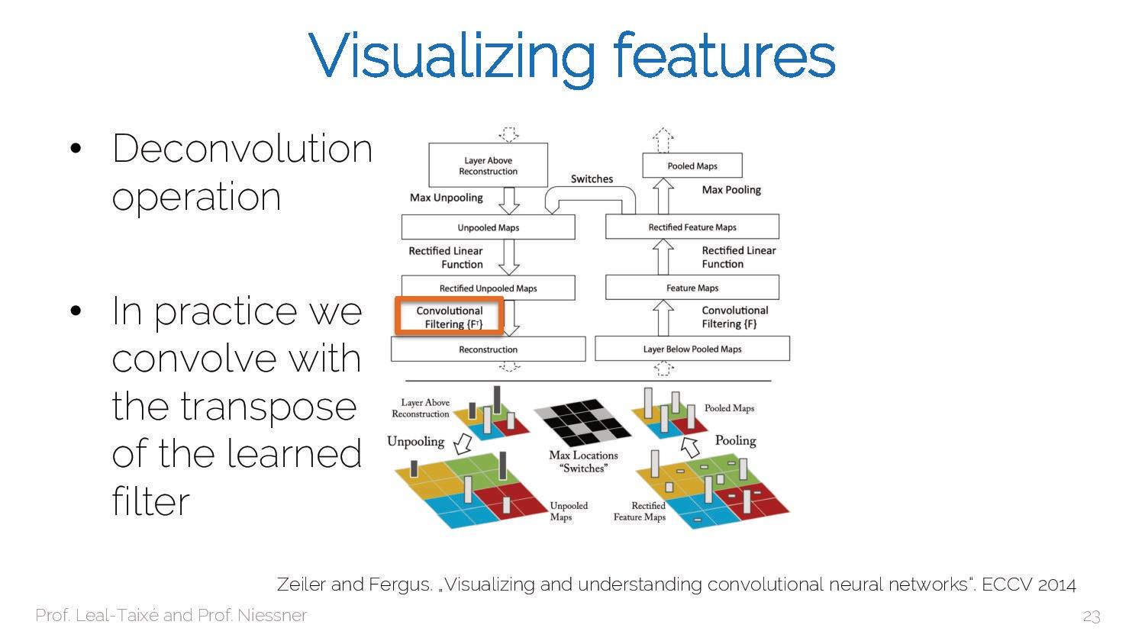

Slide 39
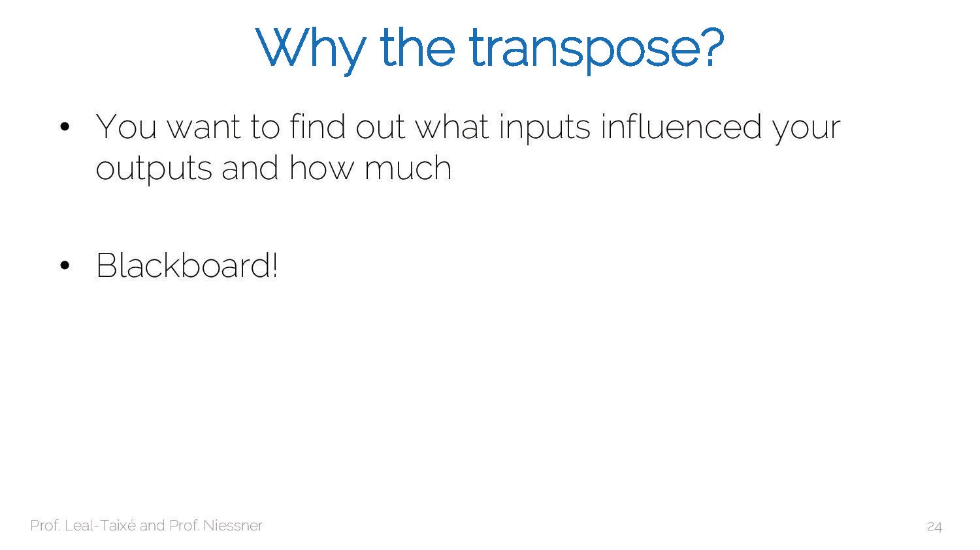

Slide 40
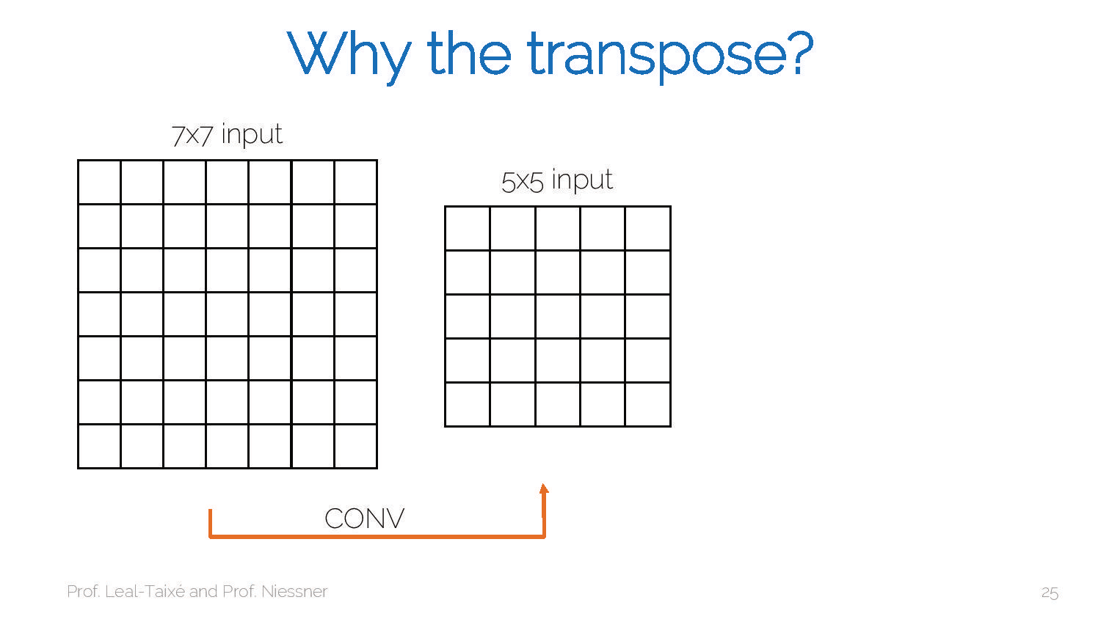

Slide 41
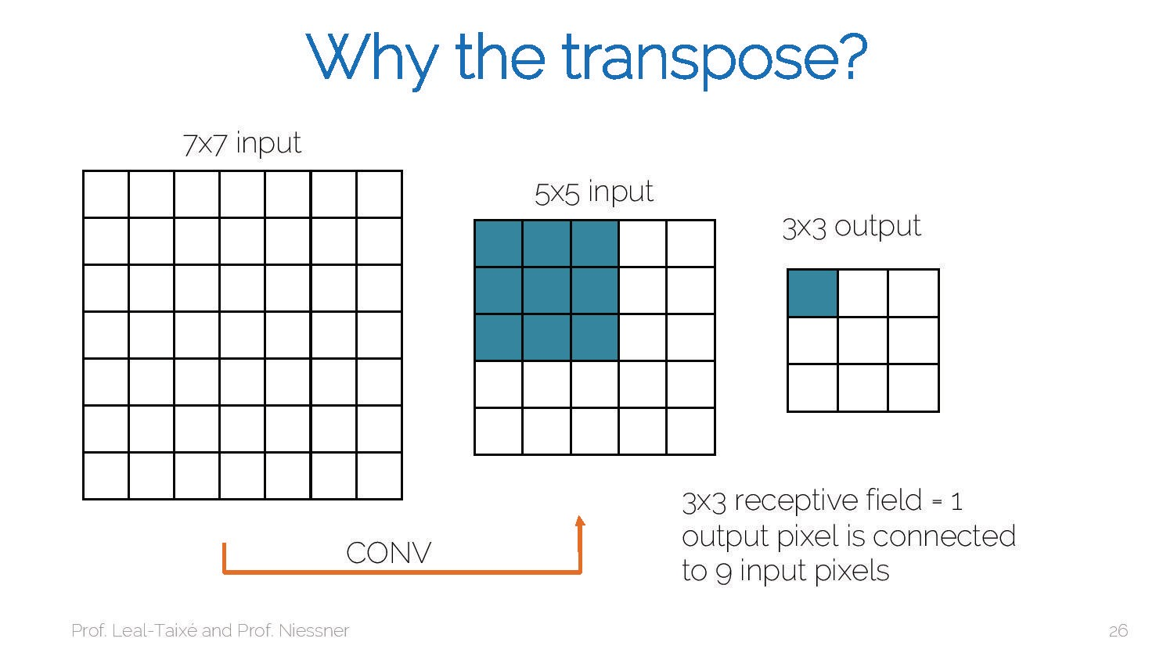

Slide 42


Slide 43


Slide 44


Slide 45


Slide 46


Slide 47


Slide 48


Slide 49


Slide 50


Slide 51


Slide 52


Slide 53


Slide 54


Slide 55


Slide 56


Slide 57


Slide 58


Slide 59


Slide 60


Slide 61


Slide 62
Intermediate Features via (guided) backprop
Pick a single intermediate neuron, e.g. one value in 128 x 13 x 13 conv5 feature map
Compute gradient of neuron value with respect to image pixels
Zeiler and Fergus, “Visualizing and Understanding Convolutional Networks”, ECCV 2014 Springenberg et al, “Striving for Simplicity: The All Convolutional Net”, ICLR Workshop 2015
Lecture 14 - 20

Slide 63

Intermediate Features via (guided) backprop
ReLU
Pick a single intermediate neuron, e.g. one value in 128 x 13 x 13 conv5 feature map
Compute gradient of neuron value with respect to image pixels
Images come out nicer if you only backprop positive gradients through
Zeiler and Fergus, “Visualizing and Understanding Convolutional Networks”, ECCV 2014 Springenberg et al, “Striving for Simplicity: The All Convolutional Net”, ICLR Workshop 2015
each ReLU (guided backprop)
November 4, 2019
Lecture 14 - 21

Slide 64


Intermediate Features via (guided) backprop
Maximally activating patches (Each row is a different neuron)
Guided Backprop
Zeiler and Fergus, “Visualizing and Understanding Convolutional Networks”, ECCV 2014 Springenberg et al, “Striving for Simplicity: The All Convolutional Net”, ICLR Workshop 2015 Figure copyright Jost Tobias Springenberg, Alexey Dosovitskiy, Thomas Brox, Martin Riedmiller, 2015; reproduced with permission.

Slide 65


Intermediate Features via (guided) backprop
Maximally activating patches (Each row is a different neuron)
Guided Backprop
Zeiler and Fergus, “Visualizing and Understanding Convolutional Networks”, ECCV 2014 Springenberg et al, “Striving for Simplicity: The All Convolutional Net”, ICLR Workshop 2015 Figure copyright Jost Tobias Springenberg, Alexey Dosovitskiy, Thomas Brox, Martin Riedmiller, 2015; reproduced with permission.

Slide 66


Slide 67


Slide 68


Slide 69


Slide 70


Slide 71


Slide 72


Slide 73
Visualizing CNN Features: Gradient Ascent
(Guided) backprop: Find the part of an image that a neuron responds to
Gradient ascent: Generate a synthetic image that maximally activates a neuron
+ R(I)
I* = arg max_{I}
f(I)
Neuron value
Natural image regularizer

Slide 74

Visualizing CNN Features: Gradient Ascent
1. Initialize image to zeros
score for class c (before Softmax)
zero image
Repeat:
Forward image to compute current scores
Backprop to get gradient of neuron value with respect to image pixels
Make a small update to the image

Slide 75
Visualizing CNN Features: Gradient Ascent
Simple regularizer: Penalize L2 norm of generated image
Simonyan, Vedaldi, and Zisserman, “Deep Inside Convolutional Networks: Visualising Image Classification Models and Saliency Maps”, ICLR Workshop 2014.
Figures copyright Karen Simonyan, Andrea Vedaldi, and Andrew Zisserman, 2014; reproduced with permission.

Slide 76

Visualizing CNN Features: Gradient Ascent
Simple regularizer: Penalize L2 norm of generated image
Simonyan, Vedaldi, and Zisserman, “Deep Inside Convolutional Networks: Visualising Image Classification Models and Saliency Maps”, ICLR Workshop 2014.
Figures copyright Karen Simonyan, Andrea Vedaldi, and Andrew Zisserman, 2014; reproduced with permission.

Slide 77

Visualizing CNN Features: Gradient Ascent
Simple regularizer: Penalize L2 norm of generated image
Simonyan, Vedaldi, and Zisserman, “Deep Inside Convolutional Networks: Visualising Image Classification Models and Saliency Maps”, ICLR Workshop 2014.
Figures copyright Karen Simonyan, Andrea Vedaldi, and Andrew Zisserman, 2014; reproduced with permission.

Slide 78
Visualizing CNN Features: Gradient Ascent
Better regularizer: Penalize L2 norm of image; also during optimization periodically
Gaussian blur image
Clip pixels with small values to 0
Clip pixels with small gradients to 0
Yosinski et al, “Understanding Neural Networks Through Deep Visualization”, ICML DL Workshop 2014.

Slide 79

Visualizing CNN Features: Gradient Ascent
Better regularizer: Penalize L2 norm of image; also during optimization periodically
Gaussian blur image
Clip pixels with small values to 0
Clip pixels with small gradients to 0
Yosinski et al, “Understanding Neural Networks Through Deep Visualization”, ICML DL Workshop 2014.

Slide 80

Visualizing CNN Features: Gradient Ascent
Better regularizer: Penalize L2 norm of image; also during optimization periodically
Gaussian blur image
Clip pixels with small values to 0
Clip pixels with small gradients to 0
Yosinski et al, “Understanding Neural Networks Through Deep Visualization”, ICML DL Workshop 2014.

Slide 81

Visualizing CNN Features: Gradient Ascent
Use the same approach to visualize intermediate features
Yosinski et al, “Understanding Neural Networks Through Deep Visualization”, ICML DL Workshop 2014.

Slide 82


Visualizing CNN Features: Gradient Ascent
Adding “multi-faceted” visualization gives even nicer results: (Plus more careful regularization, center-bias)
Nguyen et al, “Multifaceted Feature Visualization: Uncovering the Different Types of Features Learned By Each Neuron in Deep Neural Networks”, ICML Visualization for Deep Learning Workshop 2016.

Slide 83

Visualizing CNN Features: Gradient Ascent
Nguyen et al, “Multifaceted Feature Visualization: Uncovering the Different Types of Features Learned By Each Neuron in Deep Neural Networks”, ICML Visualization for Deep Learning Workshop 2016.

Slide 84

Visualizing CNN Features: Gradient Ascent
Nguyen et al, “Synthesizing the preferred inputs for neurons in neural networks via deep generator networks,” NIPS 2016
Lecture 14 - 35

Slide 85
Adversarial Examples
Start from an arbitrary image
Pick an arbitrary category
Modify the image (via gradient ascent) to maximize the class score
Stop when the network is fooled
Szegedy et al, “Intriguing properties of neural networks”, 2013
Lecture 14 - 36

Slide 86

Adversarial Examples
Boat image is CC0 public domain Elephant image is CC0 public domain
Lecture 14 - 37

Slide 87



Feature Inversion
Given a CNN feature vector for an image, find a new image that:
Matches the given feature vector
“looks natural” (image prior regularization)
Given feature
vector
Features of new image
Total Variation regularizer (encourages spatial smoothness)
Mahendran and Vedaldi, “Understanding Deep Image Representations by Inverting Them”, CVPR 2015
Lecture 14 - 38

Slide 88

Feature Inversion
Reconstructing from different layers of VGG-16
Mahendran and Vedaldi, “Understanding Deep Image Representations by Inverting Them”, CVPR 2015
Figure from Johnson, Alahi, and Fei-Fei, “Perceptual Losses for Real-Time Style Transfer and Super-Resolution”, ECCV 2016.
Lecture 14 - 39

Slide 89


Slide 90


Slide 91


Slide 92


Slide 93


DeepDream: Amplify Existing Features
Rather than synthesizing an image to maximize a specific neuron, instead try to amplify the neuron activations at some layer in the network
Choose an image and a layer in a CNN; repeat:
1. Forward: compute activations at chosen layer
2. Set gradient of chosen layer equal to its activation
3. Backward: Compute gradient on image
4. Update image
Mordvintsev, Olah, and Tyka, “Inceptionism: Going Deeper into Neural Networks”, Google Research Blog. Images are licensed under CC-BY 4.0
Lecture 14 - 40

Slide 94
DeepDream: Amplify Existing Features
Rather than synthesizing an image to maximize a specific neuron, instead try to amplify the neuron activations at some layer in the network
Choose an image and a layer in a CNN; repeat:
1. Forward: compute activations at chosen layer
Equivalent to:
I* = arg max_{I} ∑_{i} f_{i}(I)
2
2. Set gradient of chosen layer equal to its activation
3. Backward: Compute gradient on image
4. Update image
Mordvintsev, Olah, and Tyka, “Inceptionism: Going Deeper into Neural Networks”, Google Research Blog. Images are licensed under CC-BY 4.0
Lecture 14 - 41

Slide 95

DeepDream: Amplify Existing Features
Code is very simple but it uses a couple tricks:
(Code is licensed under Apache 2.0)
Forward / backward
Also uses multiscale processing for a fractal effect (not shown)

Slide 96
DeepDream: Amplify Existing Features
Code is very simple but it uses a couple tricks:
(Code is licensed under Apache 2.0)
Jitter image Forward / backward
Also uses multiscale processing for a fractal effect (not shown)

Slide 97
DeepDream: Amplify Existing Features
Code is very simple but it uses a couple tricks:
(Code is licensed under Apache 2.0)
Jitter image Forward / backward L1 Normalize gradients
Also uses multiscale processing for a fractal effect (not shown)

Slide 98
DeepDream: Amplify Existing Features
Code is very simple but it uses a couple tricks:
(Code is licensed under Apache 2.0)
Jitter image Forward / backward L1 Normalize gradients
Clip pixel values
Also uses multiscale processing for a fractal effect (not shown)

Slide 99

Sky image is licensed under CC-BY SA 3.0
Lecture 14 - 46

Slide 100

Image is licensed under CC-BY 3.0
Lecture 14 - 47

Slide 101

Image is licensed under CC-BY 4.0
Lecture 14 - 48

Slide 102

Image is licensed under CC-BY 4.0
Lecture 14 - 49

Slide 103

Image is licensed under CC-BY 3.0
Lecture 14 - 50

Slide 104

Image is licensed under CC-BY 4.0
Lecture 14 - 51

Slide 105


Texture Synthesis
Given a sample patch of some texture, can we generate a bigger image of the same texture?
Input
Output
Output image is licensed under the MIT license

Slide 106
Texture Synthesis: Nearest Neighbor
Generate pixels one at a time in scanline order; form neighborhood of already generated pixels and copy nearest neighbor from input
Wei and Levoy, “Fast Texture Synthesis using Tree-structured Vector Quantization”, SIGGRAPH 2000 Efros and Leung, “Texture Synthesis by Non-parametric Sampling”, ICCV 1999
Output image is licensed under the MIT license

Slide 107




Texture Synthesis: Nearest Neighbor
Images licensed under the MIT license

Slide 108


Texture Synthesis with Neural Networks: Gram Matrix
C
H
w
This image is in the public domain.
Each layer of CNN gives C x H x W tensor of features; H x W grid of C-dimensional vectors

Slide 109
Texture Synthesis with Neural Networks: Gram Matrix
C
H
C
w
This image is in the public domain.
Each layer of CNN gives C x H x W tensor of features; H x W grid of C-dimensional vectors
Outer product of two C-dimensional vectors gives C x C matrix of elementwise products

Slide 110
Texture Synthesis with Neural Networks: Gram Matrix
C
H
C
w
This image is in the public domain.
Each layer of CNN gives C x H x W tensor of features; H x W grid of C-dimensional vectors
Outer product of two C-dimensional vectors gives C x C matrix of elementwise products
Average over all HW pairs gives Gram Matrix of shape C x C giving unnormalized covariance

Slide 111
Texture Synthesis with Neural Networks: Gram Matrix
C
H
C
w
This image is in the public domain.
Each layer of CNN gives C x H x W tensor of features; H x W grid of C-dimensional vectors
Efficient to compute; reshape features from
Outer product of two C-dimensional vectors gives C x C matrix of elementwise products
C x H x W to F = C x HW
Average over all HW pairs gives Gram Matrix of shape C x C giving unnormalized covariance
then compute G = FF^{T}

Slide 112




Neural Texture Synthesis
Pretrain a CNN on ImageNet (VGG-19)
Run input texture forward through CNN, record activations on every layer; layer i gives feature map of shape C_{i} × H_{i} × W_{i}
At each layer compute the Gram mat giving outer product of features:
shape C_{i} × C_{i})
Initialize generated image from random noise
Pass generated image through CNN, compute Gram matrix on each layer
Compute loss: weighted sum of L2 distance between Gram matrices
Backprop to get gradient on image
Make gradient step on image
GOTO 5
rix
(

Slide 113
Neural Texture Synthesis
Pretrain a CNN on ImageNet (VGG-19)
Run input texture forward through CNN, record activations on every layer; layer i gives feature map of shape C_{i} × H_{i} × W_{i}
At each layer compute the Gram matrix giving outer product of features:
shape C_{i} × C_{i})
(
4. Initialize generated image from random noise
Pass generated image through CNN, compute Gram matrix on each layer
Compute loss: weighted sum of L2 distance between Gram matrices
Backprop to get gradient on image
Make gradient step on image
GOTO 5
Lecture 14 - 60

Slide 114

Neural Texture Synthesis
Pretrain a CNN on ImageNet (VGG-19)
Run input texture forward through CNN, record activations on every layer; layer i gives feature map of shape C_{i} × H_{i} × W_{i}
At each layer compute the Gram matrix giving outer product of features:
shape C_{i} × C_{i})
Initialize generated image from random noise
(
Pass generated image through CNN, compute Gram matrix on each layer
Compute loss: weighted sum of L2 distance between Gram matrices
Backprop to get gradient on image
Make gradient step on image
GOTO 5

Slide 115
Neural Texture Synthesis
Pretrain a CNN on ImageNet (VGG-19)
Run input texture forward through CNN, record activations on every layer; layer i gives feature map of shape C_{i} × H_{i} × W_{i}
At each layer compute the Gram matrix giving outer product of features:
shape C_{i} × C_{i})
Initialize generated image from random noise
5. Pass generated image through CNN, compute Gram matrix on each layer
(
Compute loss: weighted sum of L2 distance between Gram matrices
Backprop to get gradient on image
Make gradient step on image
GOTO 5

Slide 116
Neural Texture Synthesis
Pretrain a CNN on ImageNet (VGG-19)
Run input texture forward through CNN, record activations on every layer; layer i gives feature map of shape C_{i} × H_{i} × W_{i}
At each layer compute the Gram matrix giving outer product of features:
shape C_{i} × C_{i})
Initialize generated image from random noise
Pass generated image through CNN, compute Gram matrix on each layer
Compute loss: weighted sum of L2 distance between Gram matrices
(
Backprop to get gradient on image
Make gradient step on image
GOTO 5

Slide 117
Neural Texture Synthesis
Pretrain a CNN on ImageNet (VGG-19)
Run input texture forward through CNN, record activations on every layer; layer i gives feature map of shape C_{i} × H_{i} × W_{i}
At each layer compute the Gram matrix giving outer product of features:
shape C_{i} × C_{i})
Initialize generated image from random noise
Pass generated image through CNN, compute Gram matrix on each layer
Compute loss: weighted sum of L2 distance between Gram matrices
Backprop to get gradient on image
Make gradient step on image
(
9. GOTO 5

Slide 118
Neural Texture Synthesis
Pretrain a CNN on ImageNet (VGG-19)
Run input texture forward through CNN, record activations on every layer; layer i gives feature map of shape C_{i} × H_{i} × W_{i}
At each layer compute the Gram matrix giving outer product of features:
shape C_{i} × C_{i})
Initialize generated image from random noise
Pass generated image through CNN, compute Gram matrix on each layer
Compute loss: weighted sum of L2 distance between Gram matrices
Backprop to get gradient on image
Make gradient step on image
GOTO 5
(

Slide 119




Neural Texture Synthesis
Reconstructing texture from higher layers recovers larger features from the input texture
Gatys, Ecker, and Bethge, “Texture Synthesis Using Convolutional Neural Networks”, NIPS 2015

Slide 120

Neural Texture Synthesis: Texture = Artwork
Texture synthesis (Gram reconstruction)
Figure from Johnson, Alahi, and Fei-Fei, “Perceptual Losses for Real-Time Style Transfer and Super-Resolution”, ECCV 2016.

Slide 121

Neural Style Transfer: Feature + Gram Reconstruction
Texture synthesis (Gram reconstruction)
Feature reconstruction
Figure from Johnson, Alahi, and Fei-Fei, “Perceptual Losses for Real-Time Style Transfer and Super-Resolution”, ECCV 2016.

Slide 122



Neural Style Transfer
Content Image
Style Image
Output Image
Match features from content image and Gram matrices from style image
+
=
This image is licensed under CC-BY 3.0
Starry Night by Van Gogh is in the public domain
Gatys, Ecker, and Bethge, “Image style transfer using convolutional neural networks”, CVPR 2016

Slide 123
Neural Style Transfer
Content Image
Style Image
Output Image
+
=
This image is licensed under CC-BY 3.0
Starry Night by Van Gogh is in the public domain
This image copyright Justin Johnson, 2015. Reproduced with permission.
Gatys, Ecker, and Bethge, “Image style transfer using convolutional neural networks”, CVPR 2016

Slide 124


Style image
Output image (Start with noise)
Content image
Gatys, Ecker, and Bethge, “Image style transfer using convolutional neural networks”, CVPR 2016
Figure adapted from Johnson, Alahi, and Fei-Fei, “Perceptual Losses for Real-Time Style Transfer and Super-Resolution”, ECCV 2016.

Slide 125

Style image
Output image
Content image
Gatys, Ecker, and Bethge, “Image style transfer using convolutional neural networks”, CVPR 2016
Figure adapted from Johnson, Alahi, and Fei-Fei, “Perceptual Losses for Real-Time Style Transfer and Super-Resolution”, ECCV 2016.

Slide 126












Justin Johnson Lecture 14 - 73 November 4, 2019

Slide 127


Neural Style Transfer
Example outputs from my implementation (in Lua Torch)
Gatys, Ecker, and Bethge, “Image style transfer using convolutional neural networks”, CVPR 2016 Figure copyright Justin Johnson, 2015.

Slide 128

Neural Style Transfer
More weight to content loss
More weight to style loss

Slide 129

Neural Style Transfer
Resizing style image before running style transfer algorithm can transfer different types of features
Larger style image
Smaller style image
Gatys, Ecker, and Bethge, “Image style transfer using convolutional neural networks”, CVPR 2016 Figure copyright Justin Johnson, 2015.

Slide 130




Neural Style Transfer: Multiple Style Images
Mix style from multiple images by taking a weighted average of Gram matrices
Gatys, Ecker, and Bethge, “Image style transfer using
convolutional neural networks”, CVPR 2016 Figure copyright Justin Johnson, 2015.
Lecture 14 - 77

Slide 131

Justin Johnson Lecture 14 - 78 November 4, 2019

Slide 132

Justin Johnson Lecture 14 - 79 November 4, 2019

Slide 133

Justin Johnson Lecture 14 - 80 November 4, 2019

Slide 134

Justin Johnson Lecture 14 - 81 November 4, 2019

Slide 135
Neural Style Transfer
Problem: Style transfer requires many forward / backward passes through VGG; very slow!

Slide 136
Neural Style Transfer
Problem: Style transfer requires many forward / backward passes through VGG; very slow!
Solution: Train another neural network to perform style transfer for us!

Slide 137
Fast Neural Style Transfer
Train a feedforward network for each style
Use pretrained CNN to compute same losses as before
After training, stylize images using a single forward pass
80
Johnson, Alahi, and Fei-Fei, “Perceptual Losses for Real-Time Style Transfer and Super-Resolution”, ECCV 2016

Slide 138


Fast Neural Style Transfer
Slow
Fast
Slow
Fast
https://github.com/jcjohnson/fast-neural-style
Johnson, Alahi, and Fei-Fei, “Perceptual Losses for Real-Time Style Transfer and Super-Resolution”, ECCV 2016

Slide 139

Recall Normalization Methods?

Slide 140
Recall Normalization Methods?
Instance Normalization was developed for style transfer!

Slide 141

Fast Neural Style Transfer
Replacing batch normalization with Instance Normalization improves results
Ulyanov et al, “Texture Networks: Feed-forward Synthesis of Textures and Stylized Images”, ICML 2016 Ulyanov et al, “Instance Normalization: The Missing Ingredient for Fast Stylization”, arXiv 2016

Slide 142

One Network, Many Styles
Dumoulin, Shlens, and Kudlur, “A Learned Representation for Artistic Style”, ICLR 2017.

Slide 143


One Network, Many Styles
Use the same network for multiple styles using conditional instance normalization: learn separate scale and shift parameters per style
Single network can blend styles after training
Dumoulin, Shlens, and Kudlur, “A Learned Representation for Artistic Style”, ICLR 2017.

Slide 144


Slide 145


Slide 146


Slide 147


Slide 148


Slide 149


Slide 150


Slide 151


Slide 152


Slide 153
Summary
Many methods for understanding CNN representations
Activations: Nearest neighbors, Dimensionality reduction, maximal patches, occlusion
Gradients: Saliency maps, class visualization, fooling images, feature inversion
Fun: DeepDream, Style Transfer.

